Slide 1
html tags
MCNDHS
Ms. Eng

Slide 2
aim: forms- textbox
Do now:
Daily Grade:
On-time/attendance/not leaving the classroom: 25%
Cellphones: 25%
Notes:25%
Classwork/Homework: 25%

Slide 3
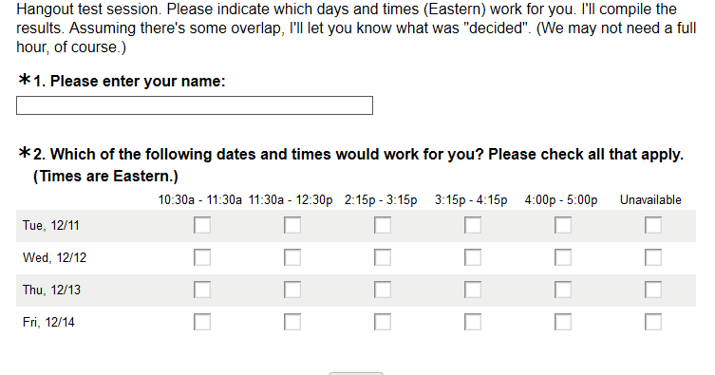
have you ever taken a survey?

Slide 4
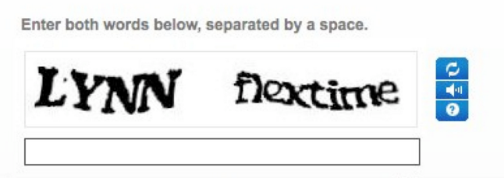
capcha

Slide 5
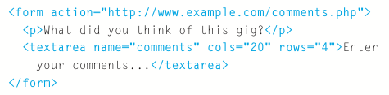
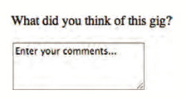
html tag
design question:
Should the columns and rows stay the same size?

Slide 6
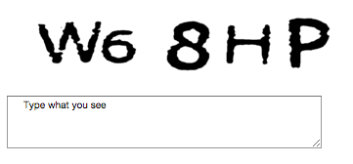
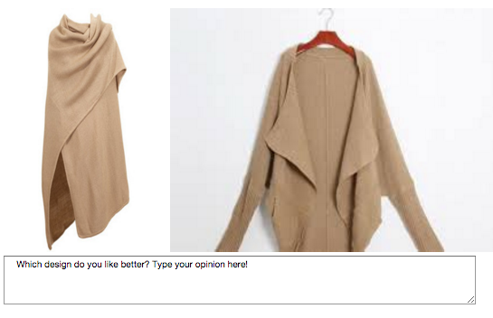
you try!

